Slide 1
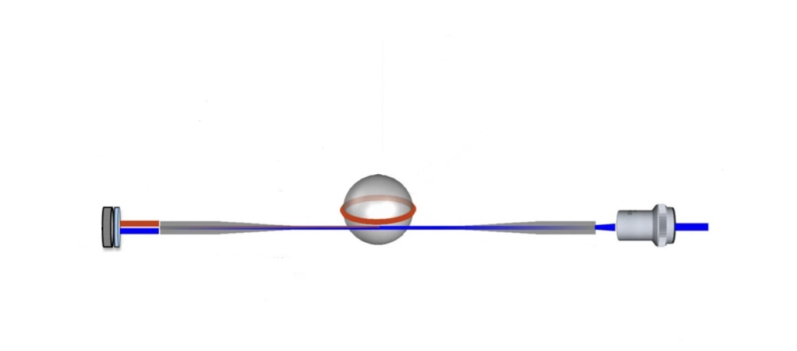
Tapered Optical Fiber and Whispering-Gallery Mode Resonators
Jacob Juca
MTSU Quantum-Optics
07/31/26
High-Sensitivity Optical Sensing
Grivas et al., Single-mode tunable laser emission in the single-exciton regime from colloidal nanocrystals (2013).

Slide 2
Why High-Sensitivity Optical Sensors?
Detect extremely small changes in physical and chemical environments.
Increase the interaction between light and surrounding materials.
Convert small environmental changes into measurable optical signals.
Zhang et al., Advances in Tapered Optical Fiber Sensor Structures: From Conventional to Novel and Emerging (2021).
2

Slide 3
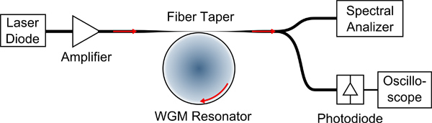
Optical Sensor System Overview
Input
Optical Fiber
Optical Analyzer
Whispering-Gallery Mode Resonator
Coillet et al., Microwave Photonics Systems Based on Whispering-Gallery-Mode Resonators (2013).
3

Slide 4
Optical Sensor System Overview Explained
Tunable Laser Source: Provides controlled optical input
Input
Optical Fiber
Analyzer
Tapered Fiber: Couples light into the resonator
Resonator: Traps light (evanescent field) in a repeating circular path
WGM Resonator
Coillet et al., Microwave Photonics Systems Based on Whispering-Gallery-Mode Resonators (2013).
Optical Spectrum Analyzer: Measures wavelength shifts
4

Slide 5
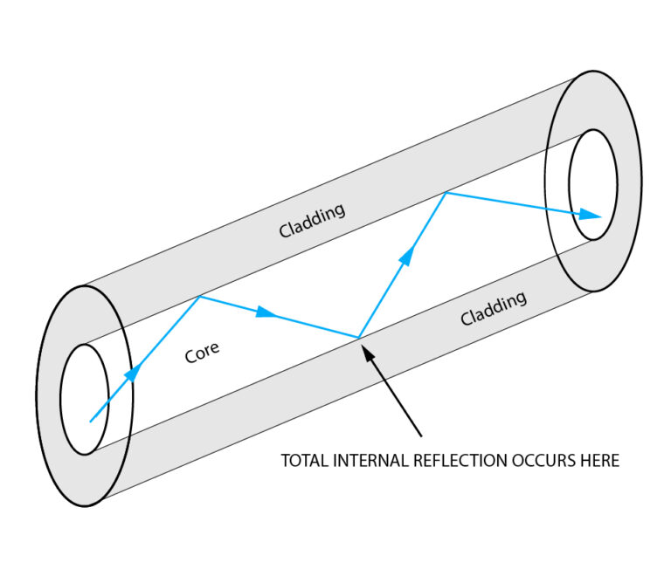
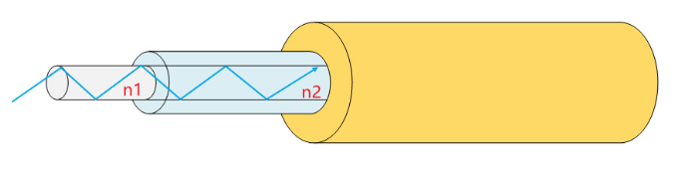


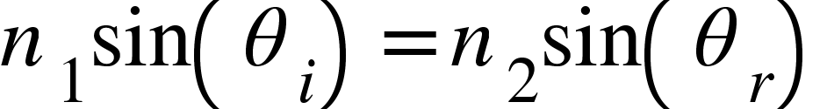
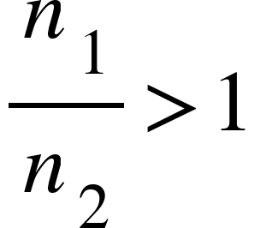
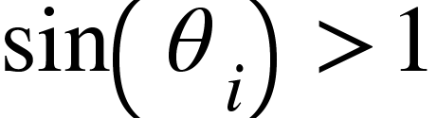



Light Confinement in Optical Fibers
Eagle Group, How Does a Fiber Laser Work? (2022).
Core
Cladding
Outer Layer
LSO Link, Everything You Need to Know About Single Mode Fiber Optic Cable (2025).
Snell’s Law:
Because:
Total Internal Reflection!
Becomes:
5

Slide 6
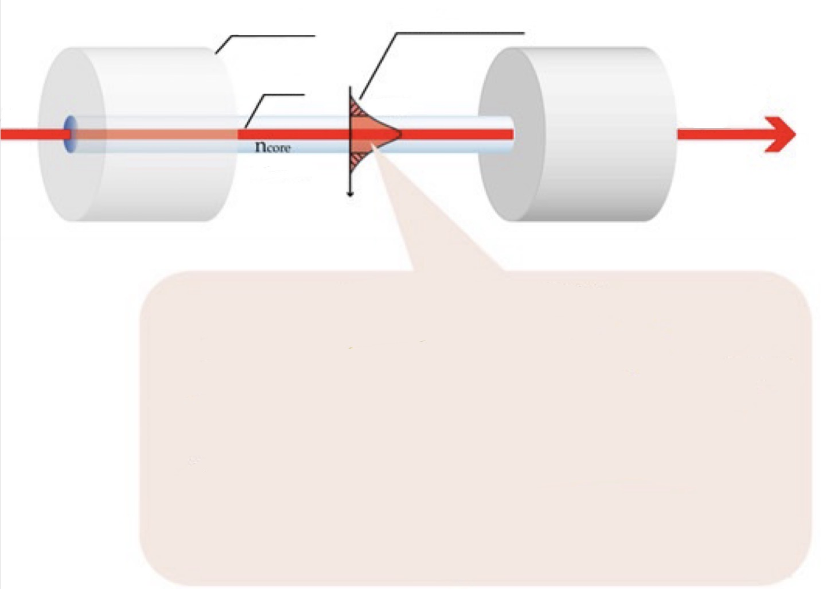
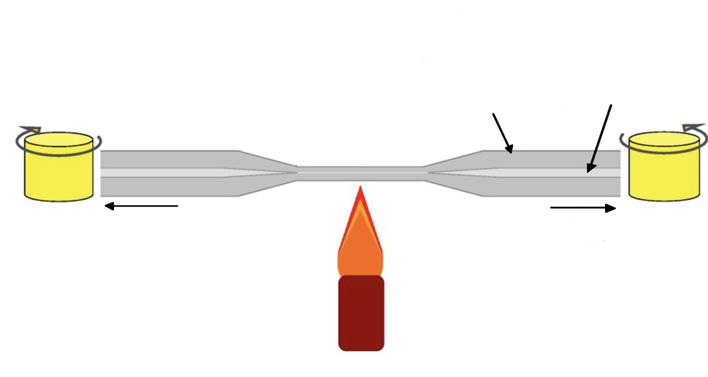
Tapered Optical Fibers and Sensing
Cladding
Evanescent Field
Core
Rotating stage
Cladding
Core
Evanescent Field:
A decaying electromagnetic field that extends beyond the fiber core and enables light–matter interaction
Rotating stage
Heat
Soares et al., Immunosensing Based on Optical Fiber Technology: Recent Advances, (2021)
Yu et al., Fabrication of an Optical Fiber Micro-Sphere with a Diameter of Several Tens of Micrometers,(2014)
6

Slide 7
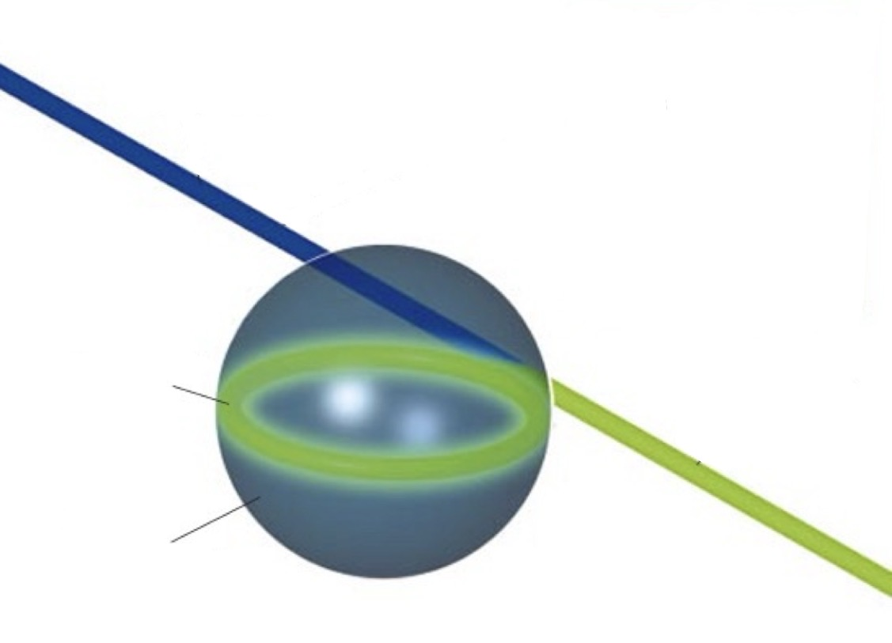
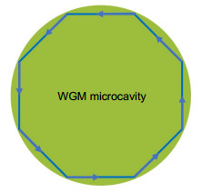

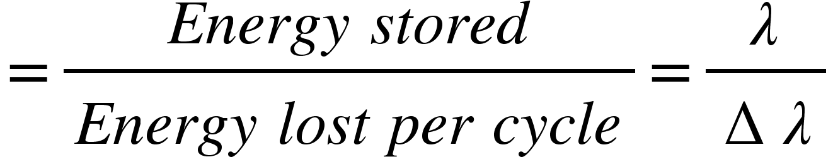
Whispering-Gallery Mode (WGM) Resonators
Zheng et al., Sensing and Lasing Applications of Whispering Gallery Mode Microresonators, 2018)
Vahala, Optical Microcavities, (2003)
= m mode
Silica Microsphere
Resonance occurs when the optical path length equals an integer multiple of the wavelength.
Quality Factor: Q
7

Slide 8
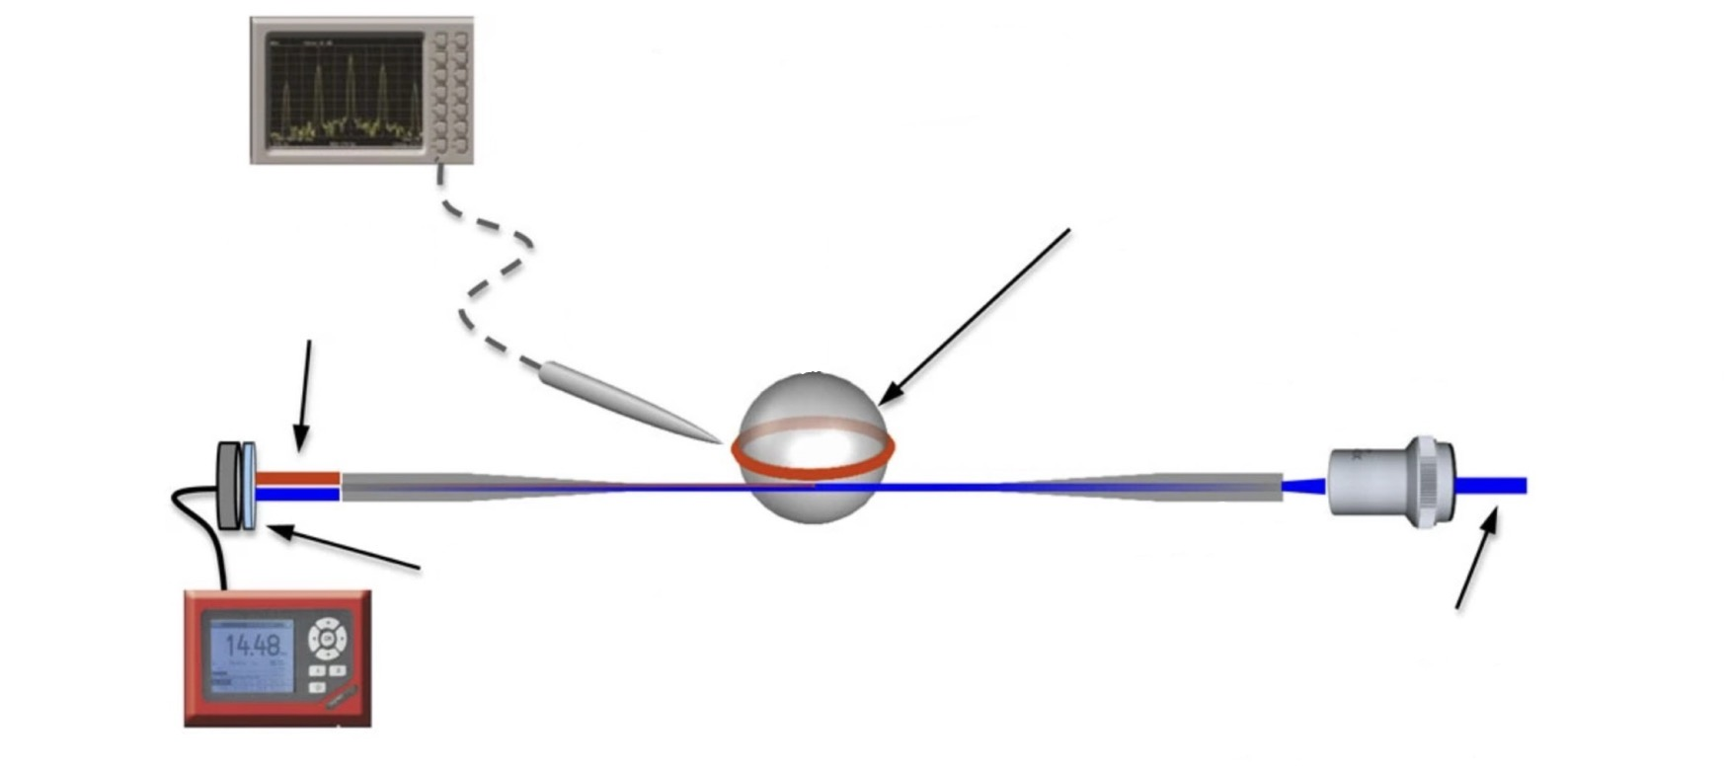
Complete WGM Optical Sensing System
1) Laser excites the tapered fiber
Spectrum Analyzer
2) Evanescent coupling transfers light into the WGM resonator.
Silica Microsphere
4
3
2
1
3) Environmental changes shift the resonance.
Power Meter
Tunable Laser
4) The optical spectrum analyzer and power meter detect the resulting signal.
Grivas et al., Single-mode tunable laser emission in the single-exciton regime from colloidal nanocrystals (2013).
8

Slide 9
Thank you for your attention!
I am open to any and all feedback!
Jacob Juca
jj8e@mtmail.mtsu.edu
9

